Slide 1
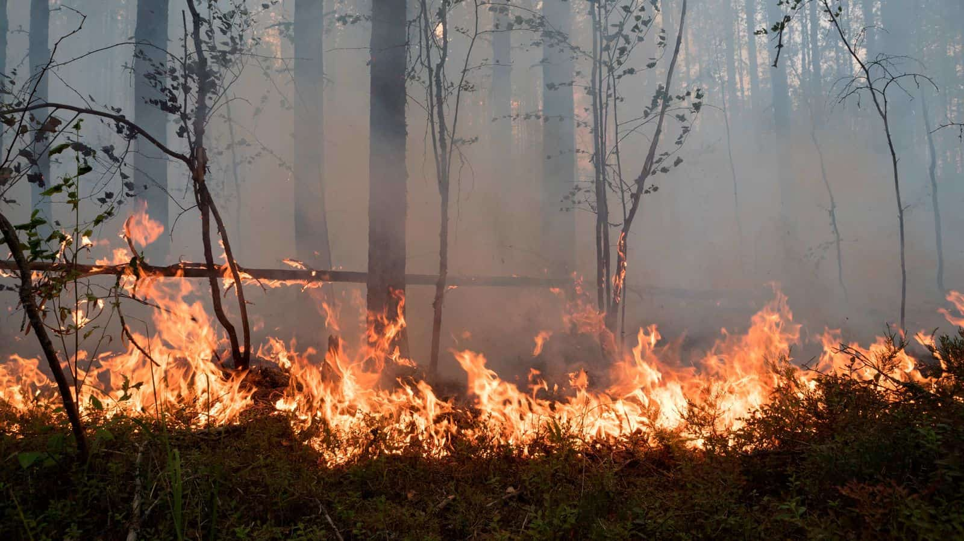

Reasons Behind Forest Fire
Group 11: Siyi Yu, Qiyue Mao, Zihan Zhao, Ziqi Li

Slide 2
CONTENT
NO.01
NO.02
NO.03
NO.04
Goal of Project
Data
Summary &Data Cleaning
Visualization& Statistical Analysis
Conclusions

Slide 3
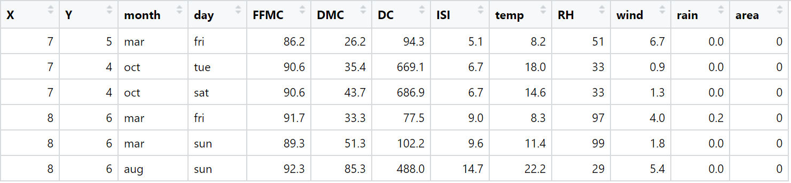
Project Selection and Objectives
Project Goal
We are planning to explore Forest Fire dataset and investigation the relationship between other factors Position, Time, FFMC, DMC, DC, ISI, Temp, RH, Wind, Rain and Burned Area

Slide 4
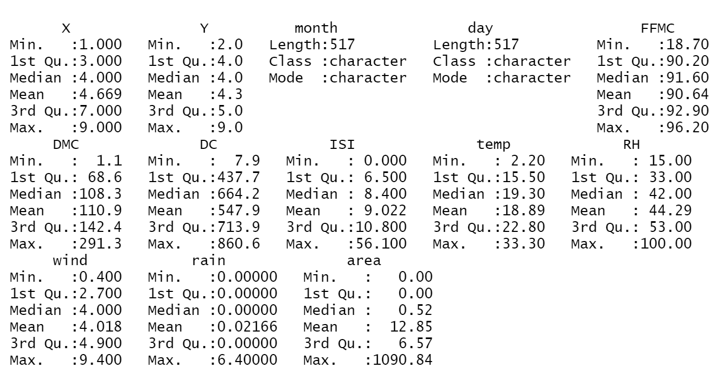
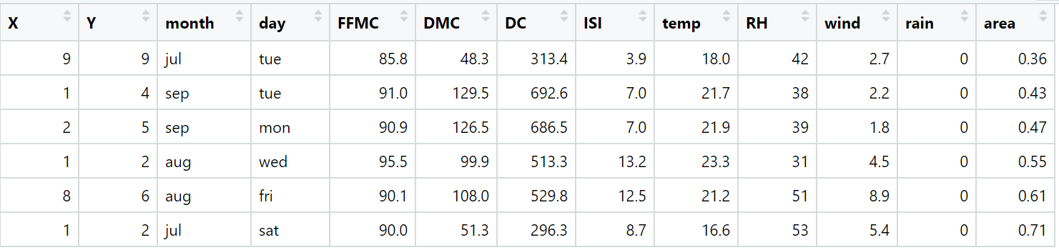
Data Pre-processing
Summary
Cleaning

Slide 5
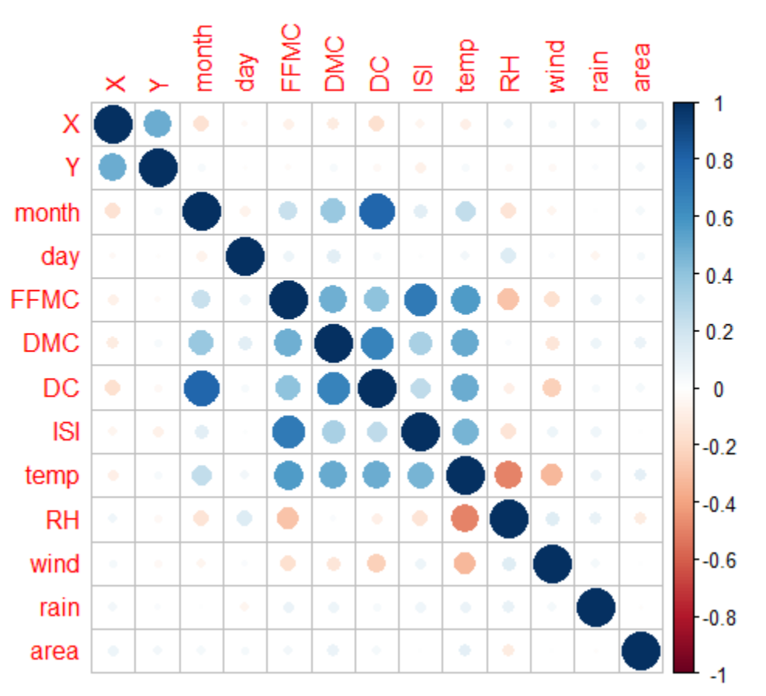
Correlation Scatter Plot
Find strength of relationship between two factors
DC and month, ISI and FFMC have strong positive relationship. They move in the same direction.
RH and temp have negative relationship. They move in the opposite direction.

Slide 6
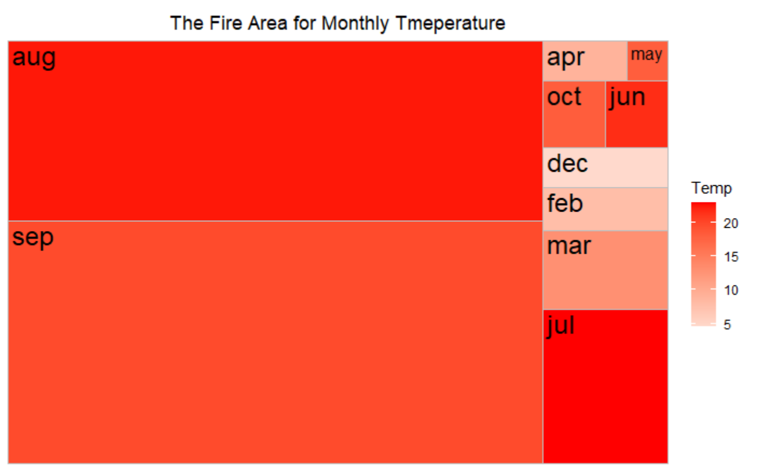
The Burned Area For Monthly Temperature
Graph type: treemap
Area: Month
Area size: The sum of burned area of month
Filter: The average temperature of month
Conclusion:
Through computing the relationship between average temperature and burned area of each month we can find that the month with higher temperature have more burned areas which means high temperature can be the factor of causing forest fire.

Slide 7
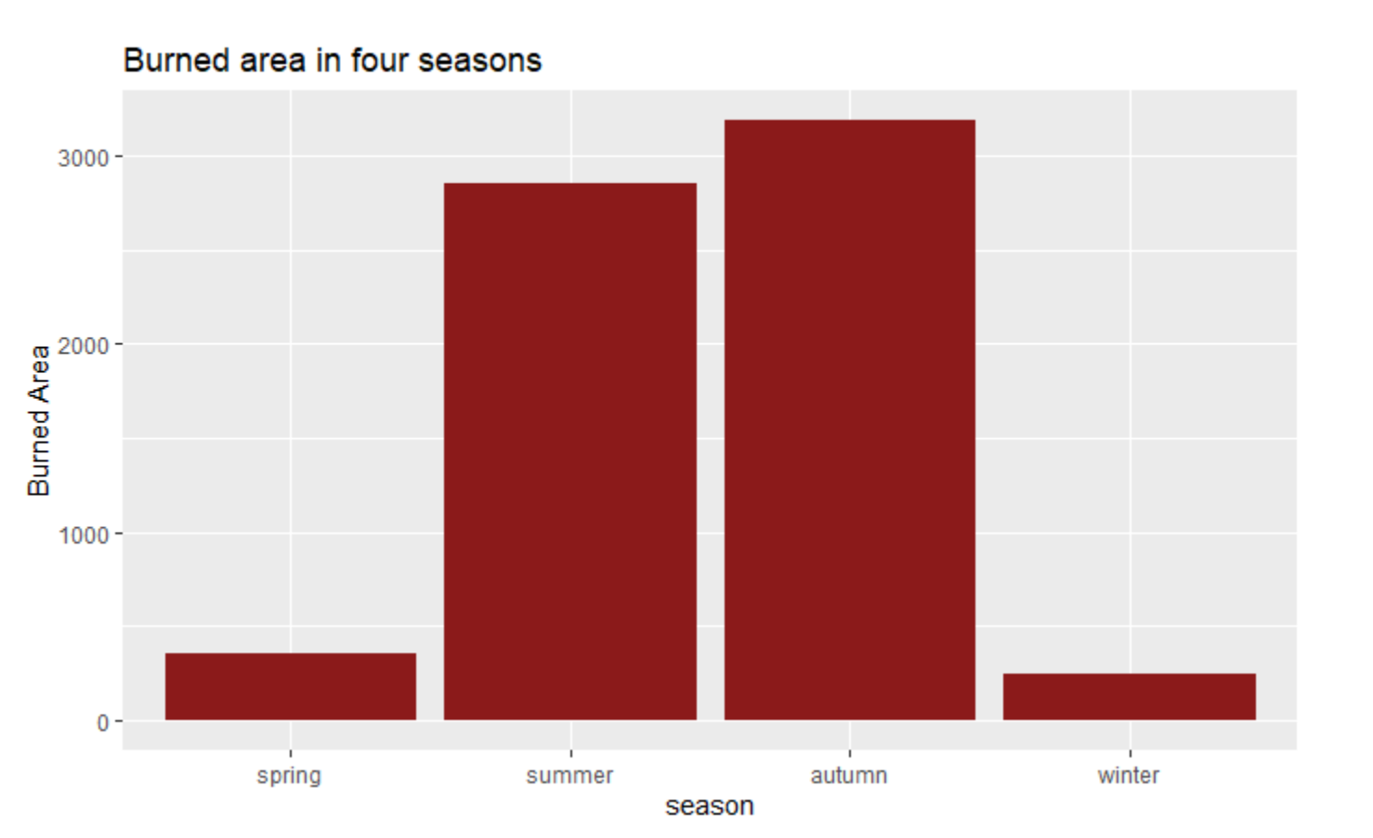
The Burned Area in Four Seasons
For easier comparison, we aggregated 12 months into four seasons to clarify the temperature distribution.
Graph type: Bar chart
X axis: seasons
Y axis: the sum of burned area of each season
Conclusion:
It is easily to distinguish that the summer and autumn have much more burned area than others. Just like the monthly graph, June, July August and September take the most part of burned areas. The summer has the highest temperature and the autumn air may be dry, these are all factors causing forest fire.

Slide 8
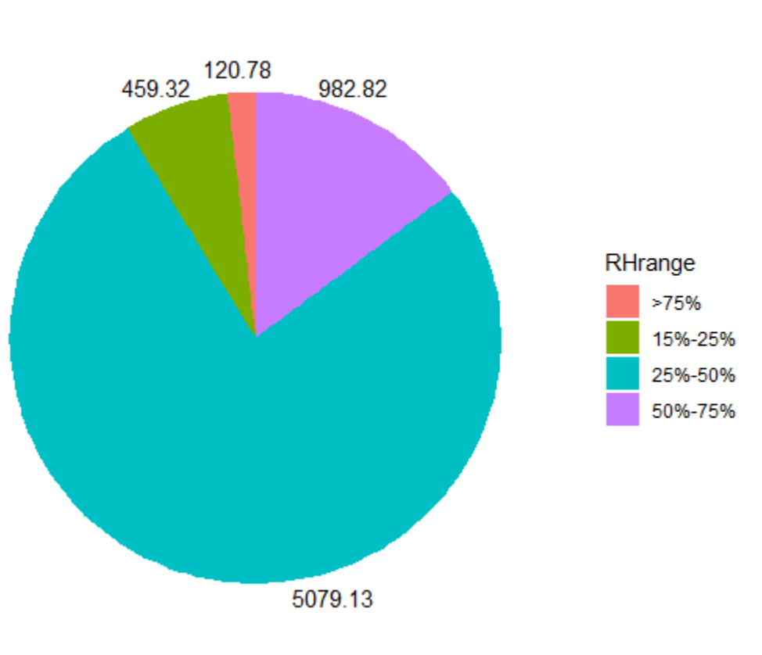
Burned Area of Different Relative Humidity
Graph type: Pie chart
Filter: Relative Humidity range
Fill: Sum of burned area of different RH range
Relative Humidity:
Relative humidity is the ratio of how much water vapor is in the air and how much water vapor the air could potentially contain at a given temperature.
Conclusion:
Relative Humidity is an important factor causing forest fire. The graph also match the research that if RH is more than 75% is hard to have forest fire and the highest fire range is 25%-50%, just like autumn.

Slide 9
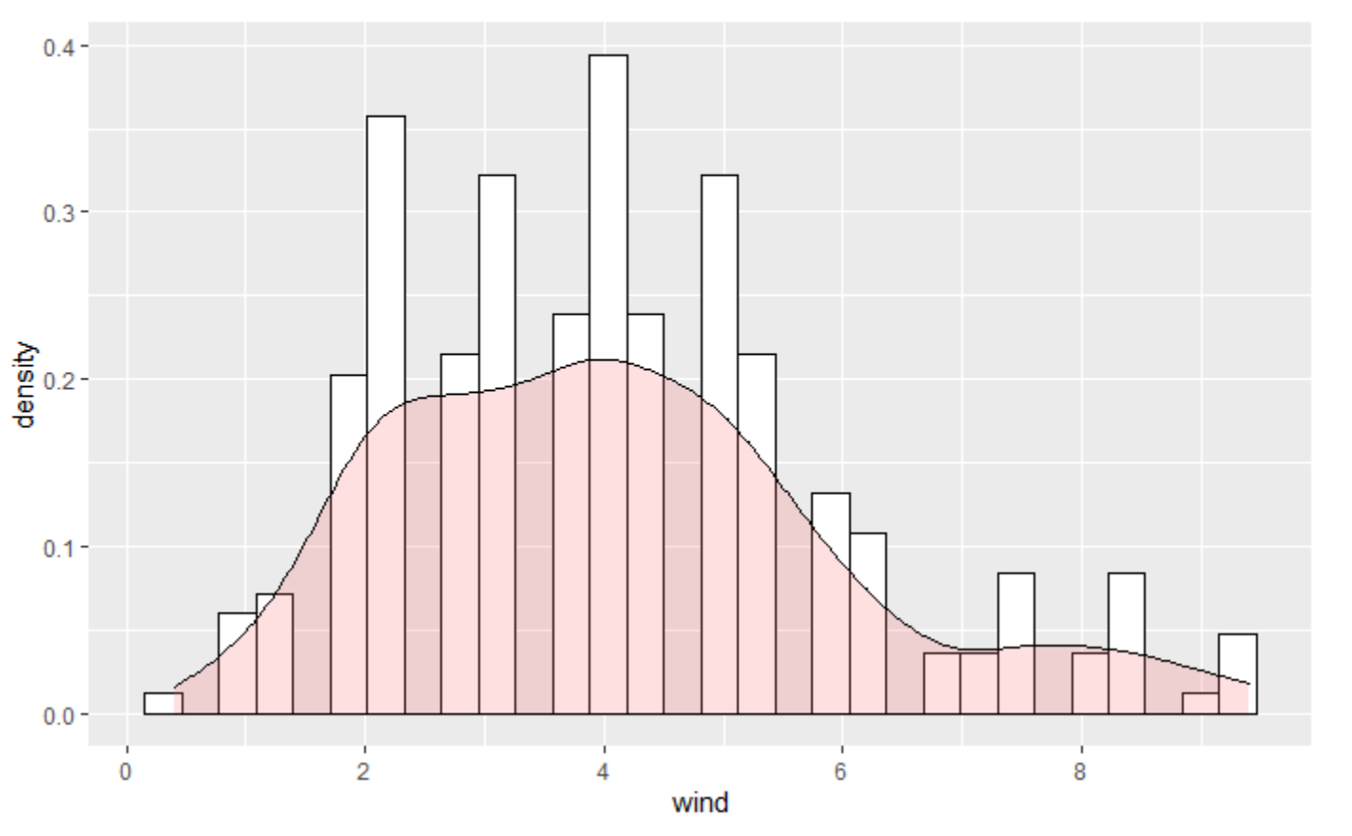
Relationship Between Windspeed and Fire Outbreak
Histogram chart & density chart.
Most forest fire outbreak happened when the windspeed is 4.2km/h.
Right skewed.
Probably because wind at this range is strong enough to spread the fire but not too strong that may block the oxygen.

Slide 10
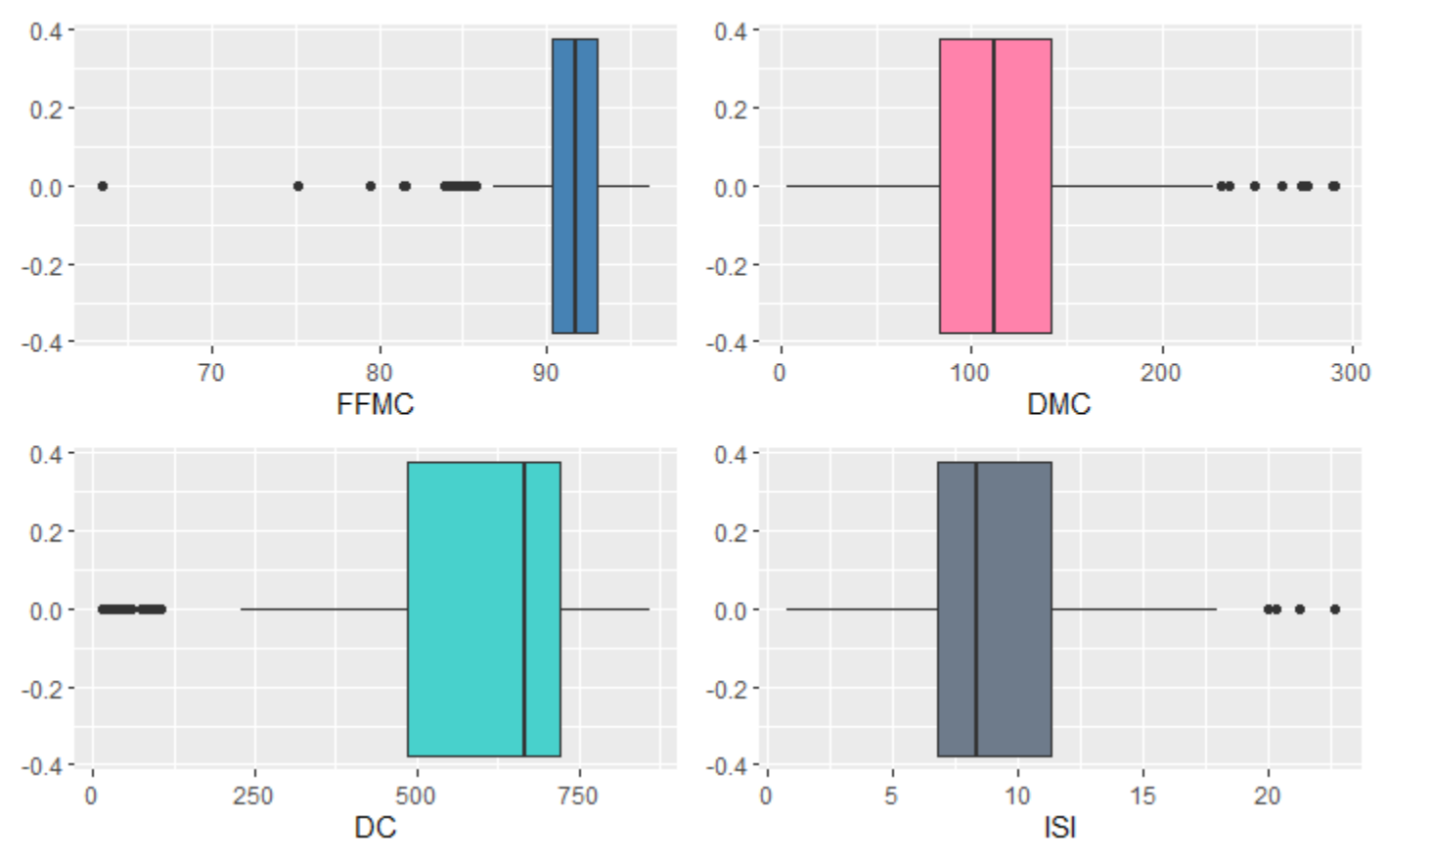
FFMC, DMC, DC, ISI and Fire Outbreak
Definition of factors:
Fine Fuel Moisture Code (FFMC),
Duff Moisture Code (DMC),
Drought Code (DC),
Initial Spread Index (ISI)
DC: left skewed w/ median around 666.
FFMC: normally distributed w/ median around 92.
ISI: Slightly right skewed w/ median around 8.
DMC: normally distributed w/ median around 111.

Slide 11
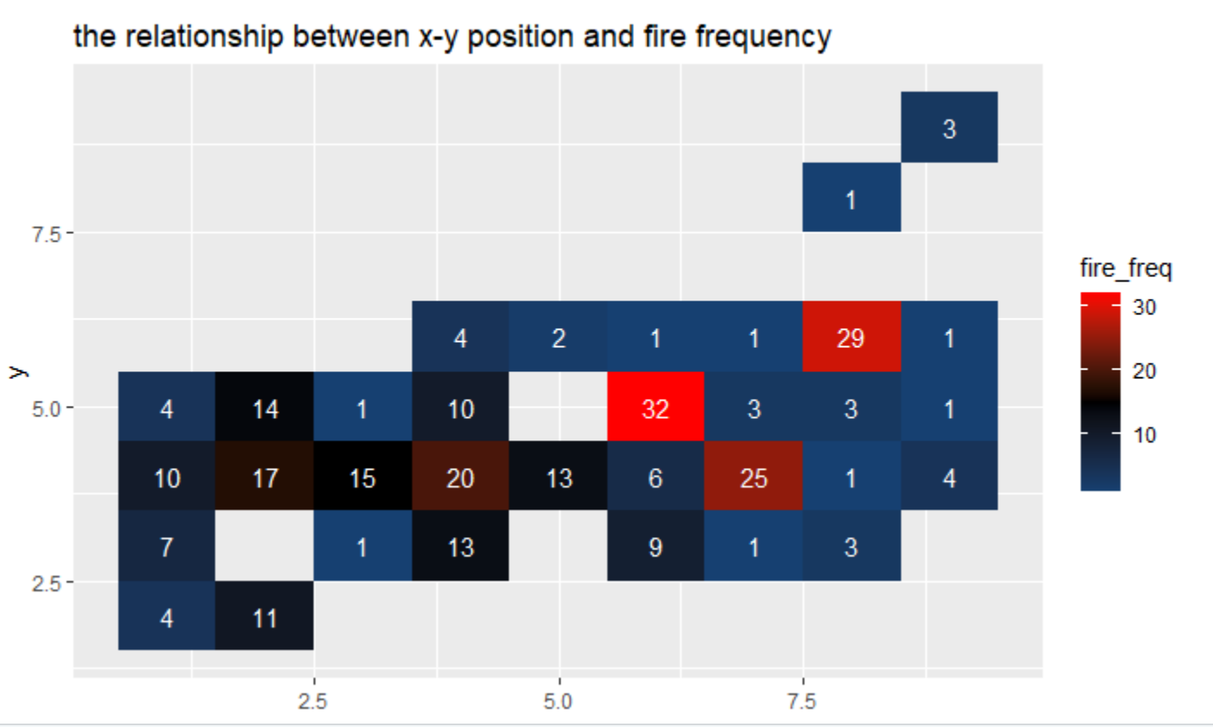
The Burned Area Frequency for Position
Interpretation
Graph type : heatmap;
Label x : x-axis spatial coordinate;
Label y : y-axis spatial coordinate;
Filter : fire frequency;
Conclusion : the chart is an illustration
of fire frequency in different positions
There are three locations, which are
easier to happen fires than others in
the northeast region of Portugal. People must pay more attention to these locations.

Slide 12
Conclusion
We find that there are several key factors, which influence forest fires mainly from the above plots.
1. The higher the temperature, the larger the area of ​​forest fires；
2. In summer and autumn there are larger burned area;
3. The largest proportion of burned area when relative Humidity is between 25%-50%；
4. The environment of different positions influence the fire frequency in Montesinho natural park.
…...

Slide 13
Citation
P. Cortez and A. Morais. A Data Mining Approach to Predict Forest Fires using Meteorological Data. In J. Neves, M. F. Santos and J. Machado Eds., New Trends in Artificial Intelligence, Proceedings of the 13th EPIA 2007 - Portuguese Conference on Artificial Intelligence, December, Guimaraes, Portugal, pp. 512-523, 2007. APPIA, ISBN-13 978-989-95618-0-9. Available at: http://www.dsi.uminho.pt/~pcortez/fires.pdf

Slide 14


